Slide 1
Frequency as scarce resource

Slide 2
Participants
Name | Registration No
Mwanaid R Naftar | 21100934340001
Abas J Kazen | 21100934340031
Daniel N Njile | 21100934340007
Kulwa M Kululumila | 21100934340025
Majaliwa Joseph | 21100934340006
Projestus K Protas | 21100934340029

Slide 3
Contents
Introduction
Radio Spectrum
Spectrum Administration
National Spectrum Administration
Conclusion

Slide 4
Introduction
What is frequency ?
Frequency refers to the number of oscillations or cycles per second of a wave, measured in Hertz (Hz).
In telecommunications, it pertains to the specific wavelengths used to transmit data wirelessly.
Importance in Telecommunications.
Frequencies are the backbone of wireless communication, enabling services like radio, television, mobile phones, and Wi-Fi.

Slide 5
Introduction
Why considered as scarce resource ?
This is because only portion of electromagnetic spectrum frequencies suitable for communication (3 kHz to 300 GHz) is limited resource, leading to challenges in accommodating the growing number of wireless devices and services.
Additionally the increase of demands like, Mobile networks(4G or 5G), IoT, Broadcasting services
Our Role is to allocate unique frequency to each device since Overlapping frequencies can cause signal quality degradation.s

Slide 6
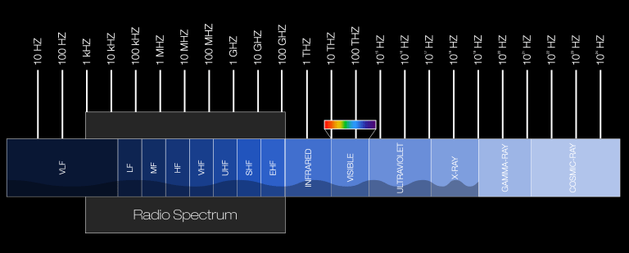
Radio Spectrum
What is the Radio Spectrum?
Radio spectrum is the range of electromagnetic frequencies used for wireless communication (3 kHz to 300 GHz).

Slide 7
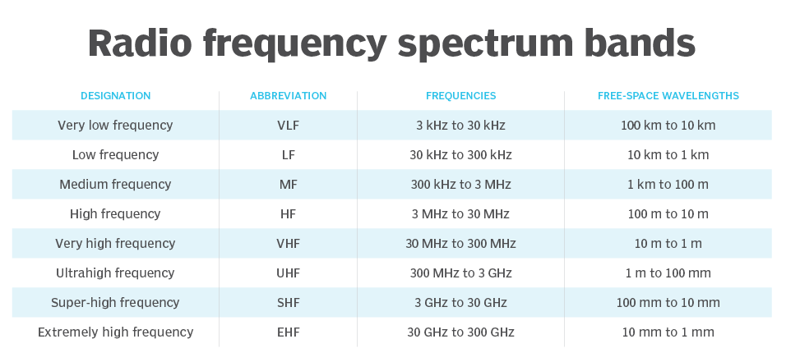
Key Spectrum Bands
Key bands of radio spectrum refers to the specific range within electromagnetic spectrum used for wireless communications and broadcasting.

Slide 8
Key Spectrum Bands
Low Frequency (LF): Long-range communication (e.g., maritime).
Medium Frequency (MF): AM radio, navigation.
High Frequency (HF): Shortwave radio, international broadcasts.
Very High Frequency (VHF): FM radio, television, aircraft communication.
Ultra High Frequency (UHF): Mobile phones, TV, and Wi-Fi.
Super High Frequency (SHF): Satellites, 5G, and radar.
Extremely High Frequency (EHF): Advanced military and space applications.

Slide 9
Spectrum Administration
Spectrum Administration
Spectrum administration involves managing and allocating radio frequencies to ensure efficient and interference-free use.
Global Governance:
International Telecommunication Union (ITU): Allocates spectrum globally and resolves cross-border interference issues.
World Radio communication Conferences (WRC): Periodically updates international spectrum usage policies.

Slide 10
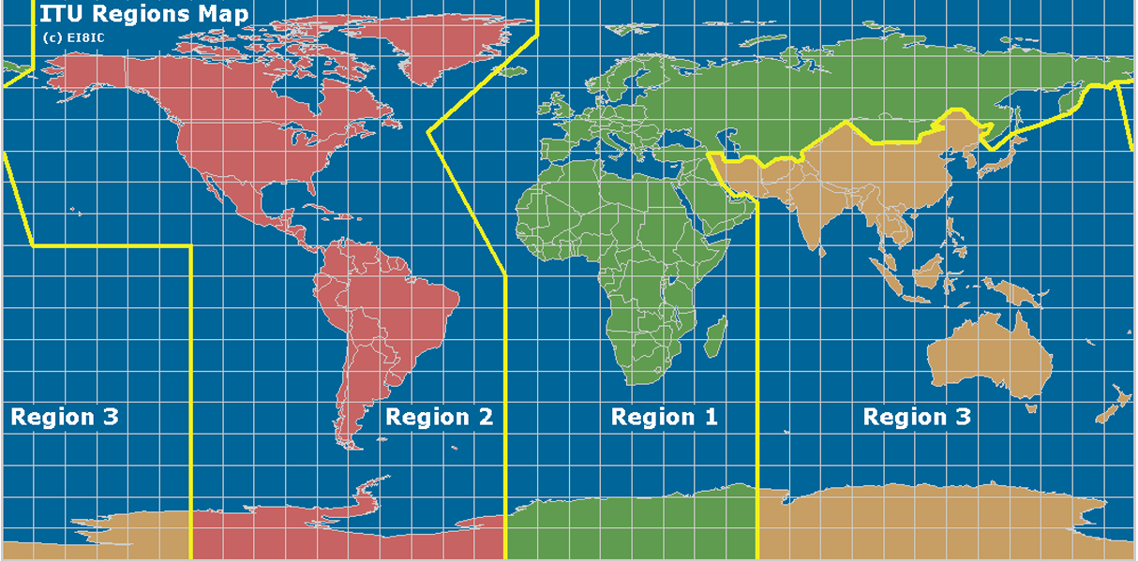
Spectrum Administration

Slide 11
National spectrum Administration
National spectrum administration refers to the management and regulation of the radio frequency spectrum by government agencies.
Key responsibilities :-
Allocation: Assigning frequency bands to different services and users.
Planning: Developing long-term strategies for spectrum use and accommodating future needs.
International Coordination: Collaborating with other countries and international organizations to communicate.

Slide 12
National spectrum Administration
In Tanzania, the Tanzania Communications Regulatory Authority (TCRA) is responsible for the national spectrum administration. The TCRA manages and regulates the radio frequency spectrum to ensure efficient and interference-free use for various communication services.
Key Responsibilities
Allocation of frequency to specific services
Assignment, TCRA licenses individual with allocated bands
Planning and Monitoring frequency

Slide 13
National Frequency Allocation Table
The National Frequency Allocation Table (NFAT) specifies purposes for which various frequency bands may be used in the United Republic of Tanzania. The Table, however, does not present any right for a frequency band use (or a specific frequency).
The use of radio frequency in the United Republic of Tanzania requires Authorization from Tanzania Communication Regulatory Authority which has been mandated to manage spectrum resource under TCRA Act, 2003 and Electronic and Postal Communications Act, 2010.

Slide 14
National Frequency Allocation Table
The National Frequency Allocation Table has been developed in conformity with the International Telecommunications Union (ITU) Radio Regulations, 2020 governing radio spectrum and regional agreements concluded or acceded to TCRA, considering the existing and future requirements of the radio frequencies in the United Republic of Tanzania.
Consider Example…

Slide 15
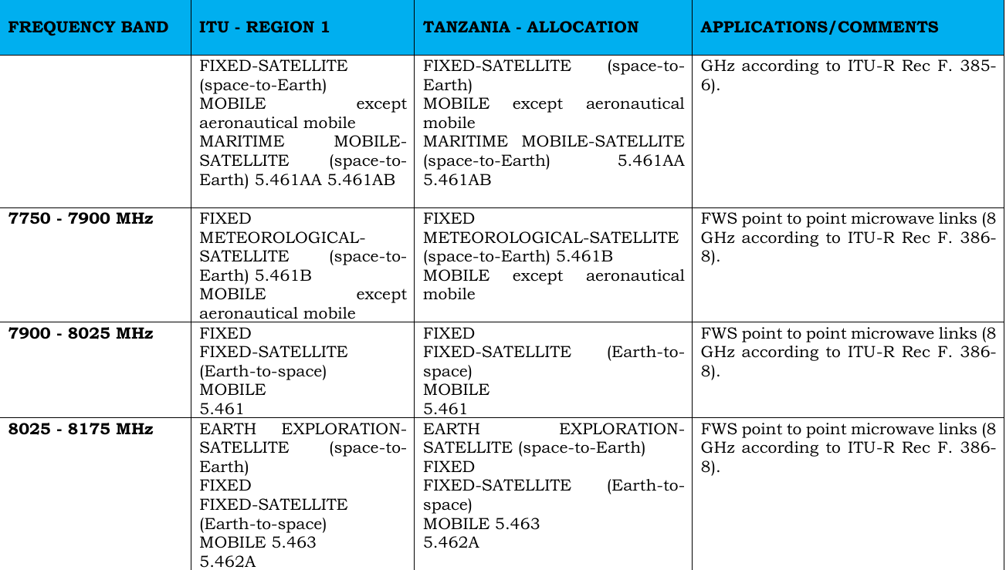
National Frequency Allocation Table

Slide 16
Conclusion
Conclusively Frequency is a critical and limited resource that fuels the digital world we rely on today. From mobile networks to satellite communications, every innovation depends on how efficiently we manage these frequencies. As demand grows, the challenge of balancing access and avoiding interference becomes more complex. So there is a need to be properly allocated and planned.

